Slide 1
Presenting My Findings (Olympics Dataset)
- by Akash Chovatiya

Slide 2
About Dataset and Client and Target Audience
The Olympics dataset, which has 120 years of data of participants in Olympics, has been chosen for analysis. This dataset consists of two tables with details of names of participants, sports they participated, countries they belong to, medals if they won any, etc.
My purpose of this analysis is concentrated to top performing countries in Olympics history to find possible reasons for their success.
My client is any firm who is working with government’s sport authority or any news media. My analysis might be helpful these clients in order to establish any strategies while preparing participants or creating news stories to aware local public.
My target audience is government itself, and elite personal trainers.

Slide 3
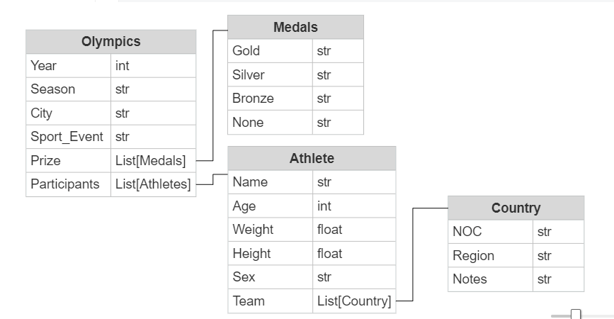
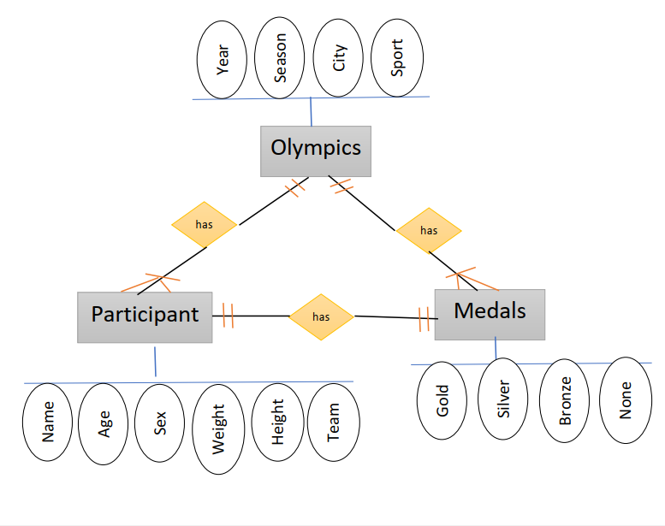
Entity Relationship Diagram (ERD) of the data

Slide 4
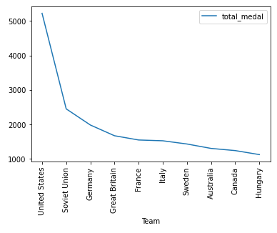
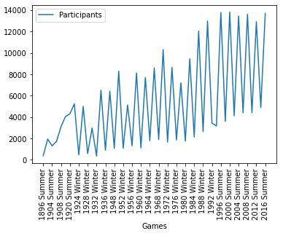
Initial Data Exploration
Top 10 countries vs. Total medals won by them
Games vs. Total No. Of Participants

Slide 5
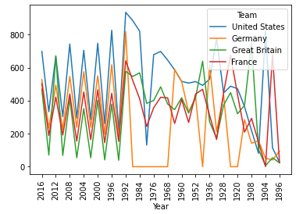
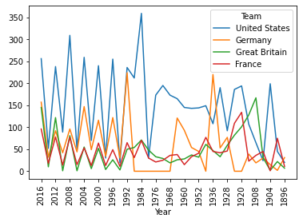
Initial Data Exploration
Participants over the years from the top 4 countries
Medals won over the years by the top 4 countries

Slide 6
The BIG PICTURE from initial data exploration – Question-to-Answer.
Soviet Union was one of the top 5 countries who won the highest number of medals in Olympics history. However, there is no data of Soviet Union after the year 1990 because it got dissolved in year 1990. So, Soviet Union was not considered in data analysis part. The United States, Germany, France and Great Britain are cosidered for analysis purpose.
What is the trend of year vs. medals won by top 4 countries? Was there a slight change over the years or it Was a sudden rise and fall over the years? What might be the reason?
Is there any relation between number of participants from one country and medals won by that country?
Is there any relationship between age group and sport? For example, participants from the specific age group predominantly win in a specific sport?
The number of participants in last 20 years have been increased more than ever in Olympics history? What might be the reason?
Is there any trend associated with season and medals won by the country?
Do men and women shine in different sports?

Slide 7
Initial Hypotheses
It is common for all countries that majority of their medals are concentrated in a certain number of sports.
The country/countries won more number of medals because it/they have sent greater number of participants.
At most of the times, a player wins a medal in different events of the same sport.

Slide 8
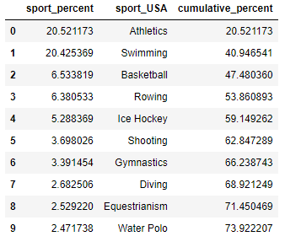
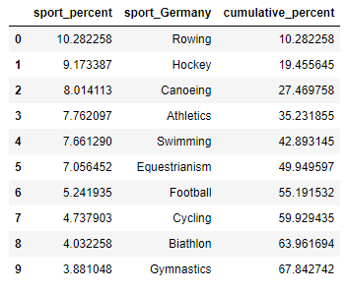
HYPOTHESIS 1: Medals are concentrated in a few sports
United States
Germany

Slide 9
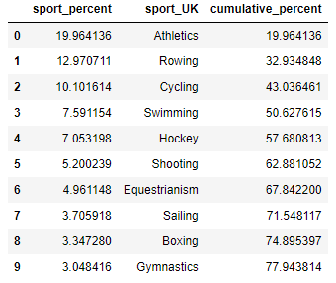
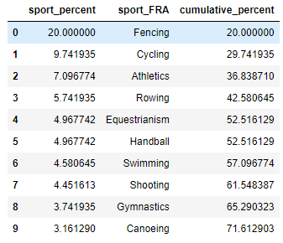
HYPOTHESIS 1: Medals are concentrated in a few sports
Great Britain
France

Slide 10
HYPOTHESIS 1: Medals are concentrated in a few sports
The tables that are presented in previous two slides shows that most of the medals won by top 4 best performing countries are concentrated in a few sports.
Above table shows that even though there are 66 categories of sports, majority of medals i.e. More than 67% are won in top 10 sports.
Based on the above facts, the first hypothesis can be considered true.
Country | % medals_concentration in top 10 sports
United States | 73.922207
Germany | 67.842742
Great Britain | 77.943814
France | 71.612903

Slide 11
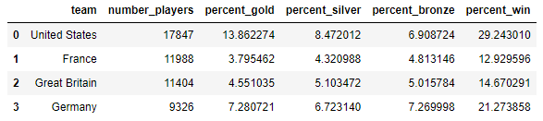
HYPOTHESIS 2: More participants means more medals
The table presented above denotes percentage of participants who won a medal out of the total participants from respective country in the Olympics.
The United States won the highest number of medals because it sent a greater number of participants to the Olympics. However, this is not true in case of other three countries as Germany has the higher win percentage even though it sent less number of participants compared to France and Great Britain.
Based on the above facts, the second hypothesis is false. But we can change the second hypothesis little bit, which can be proved.
Changed Hypothesis: The United States won the highest no. of medals because it sent a greater no. of participants.

Slide 12
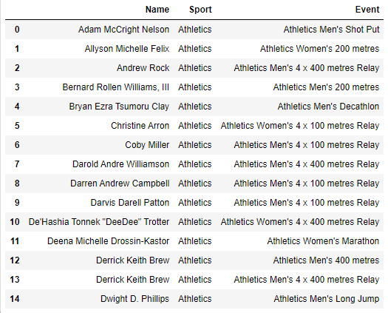
HYPOTHESIS 3: A player wins a medal in different events of the same sport
After looking into the participants in each sport and whether they won medals in different events of the same sport, the third hypothesis can be concluded false.
The reason can be found in the table shown at the right side. The tables shows that even in the ‚Athletics‘ category sport, there are different events which need different physical abilities to win in a event.

Slide 13
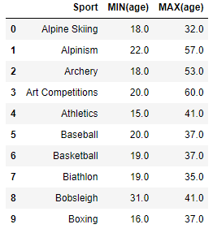
Analysis from diving deeper and going broader
The Pearson correlation coefficients between no. of medals won by countries and number of participants from those countries are as following:
Country | Pearson Correlation Coefficient
United States | 0.89791106
Germany | 0.93401656
Great Britain | 0.71517374
France | 0.70679510
No. of medals won in sports was not only concentrated to age group till 35 years. This can be proved by looking in maximum age of the participants who won medals.

Slide 14
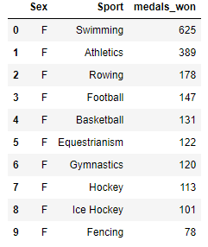
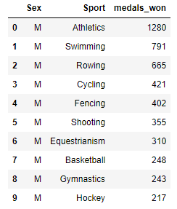
Analysis from diving deeper and going broader: Gender-wise Analysis
While doing gender-wise analysis, I found the correlation between no. of medals won by female sex and by male sex of particular country in top 10 sports. The list found was almost contained similar sports.
I learned from this analysis that in their respective countries, the attention is being given equally to both sexes’ federation in terms of funding, training programs etc.

Slide 15
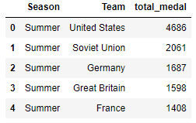
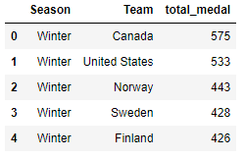
Analysis from diving deeper and going broader: Season-wise Analysis
What impact does the season have on medals won by country?
The above tables shows that top 5 countries who won the highest number of medals in winter and summer season are: Canada, United States, Norway, Sweden, Finland and in summer season are: United States, Soviet Union, Germany, Great Britain, France. The list of winter is totally differed from that of summer (except United States) because winter sports might be more famous in cold countries compared to other countries.
The up-down curve in medal history graph for top 4 best performing countries is understood by the above fact. The countries’ overall best performance is subjected to more sports played in summer compared to winter.

Slide 16


Summary of Insights
HYPOTHESIS 1: It is common for all countries that majority of their medals are concentrated in a certain number of sports.
HYPOTHESIS 2: The country/countries won more number of medals because it/they have sent greater number of participants.
Changed HYPOTHESIS 2: The United States won the highest no. of medals because it sent a greater no. of participants.
HYPOTHESIS 3: At most of the times, a player wins a medal in different events of the same sport.
Discoveries about data:
No. of medals won in sports is not only concentrated to age group till 35 years.
The list of the top 10 sports in which medals won by both genders are almost similar.
The countries’ overall best performance is subjected to more sports played in summer compared to winter. Difference in seasonal games and participation is the main reason for up-down curve in the history graph.

Slide 17

Next steps............
Age-group analysis could be done deeper. For example, which age-group tends to be most favourite to win a specific event/sport.
Is country winning a sport that has more popularity in their region?
Countries‘ popular players has not been analyzed. Analyzing which can give interesting incidents, statistics etc.
Physical attributes such as height and width could be responsible for winning some sports/events, which can be analyzed.

